Slide 1
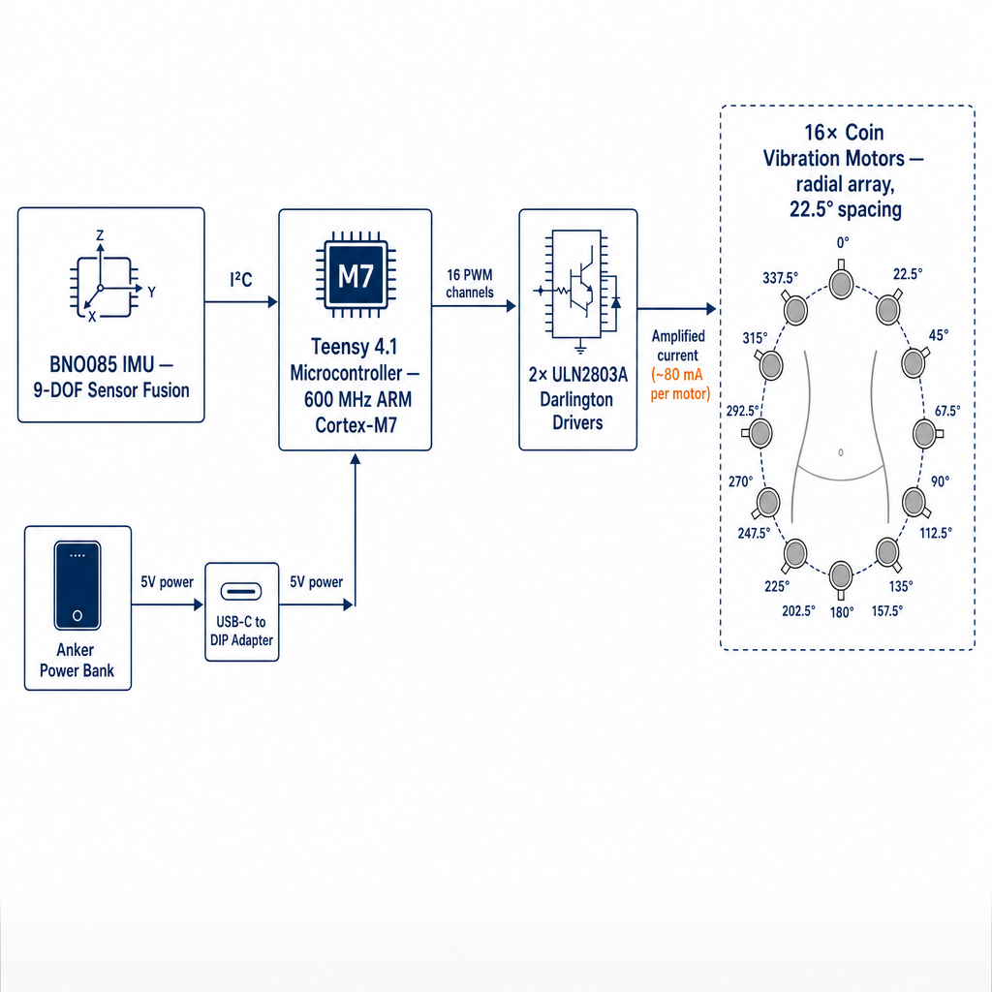
Connect Human to Environment: Replicating the feelSpace Project of University of Osnabrück
Paul Fan & Kevin Sun
McCallie School
Abstract
Design
Current Results
Further Development
In 2014, Kaspar et al. at the University of Osnabrück reported that participants who continuously wore a vibrotactile navigation belt for several weeks developed what they described as a "sixth sense" for direction. Their bodies no longer felt vibration, but instead perceived orientation directly, as if it were a native sensory modality.
This poster reports on Phase 1 of the project: building a reliable prototype and verifying short-term reproducibility of the directional perception effect. The Phase 2 of the project is to substitute cheaper functional equivalents to test whether the effect persists at consumer-grade hardware specifications.
This project pursues three goals:
Reproducibility. We replicate the original study using custom-built prototype to test whether the directional perception effect can be reliably reproduced.
Affordability (Phase 2 goal). Commercial haptic navigation belts (e.g., feelSpace naviGürtel) cost approximately €2000.
Beyond navigation. We believe that tactile feedback is an underused non-invasive human–machine communication channel. When high-bandwidth or bidirectional communication are not required, haptic augmentation can serve as a practical alternative to brain–computer interfaces without surgical risk or ethical complications.
Our priority for this prototype is verifying whether the phenomenon reported by Kaspar et al. (2014) reproduces.
System Architecture
The Teensy 4.1's 35 hardware PWM channels allow direct control of all 16 motors without an external PWM controller, reducing I²C bus load and signal latency. The ULN2803A Darlington arrays remain necessary as current drivers — the Teensy's logic-level GPIO cannot supply the ~80 mA each motor requires.
Why these components (for the prototype)
BNO085 detect directional information to the system. It provides drift-corrected absolute heading directly, which eliminates the magnetometer-drift issues.
Teensy 4.1 offers high processing headroom (600 MHz ARM Cortex-M7) and 16 native PWM channels, allowing the individual control of each motor with variable vibration intensity.
2× ULN2803A Darlington arrays supply the current required by motors.
16 coin vibration motors at 22.5° spacing match the directional resolution of the original feelSpace naviGürtel.
1. Current Status (as of poster date)
We have completed the construction and basic functional verification of the prototype CopilotBelt. Specifically:
12 coin vibration motors are mounted at about same intervals around the tactical belt and are individually controllable. 4 failed during assembly and testing.
The BNO085 IMU returns drift-corrected absolute heading over I²C.
The control firmware reads the user's current heading, compares it to a target direction, and activates the corresponding motor (the ones nearest to the target direction).
The full system runs with a type-c power input.
Verification: With the belt held at fixed orientations on the test bench, the correct motor activates for all directions. Latency from heading change to motor activation is below perceptual level.
What we have not yet measured: human perceptual performance. No subject testing has been conducted at the time.
2. What We Expect to Accomplish in the Next 1.5 Weeks
Our planned data collection focuses on Phase 1 of the reproducibility question:
Pointing-task experiment. 6-8 subjects wear the belt while it indicates random target directions. Subjects point in the perceived direction. The angular errors between the actual directions and subjects’ perceived directions are recorded.
Single-session learning curve. Each subject completes 3 blocks of 16 trials. We compare accuracy across blocks to detect short-term adaptation within a single session.
Comfort and wearability assessment. A short post-session questionnaire on weight, fit, vibration intensity, and fatigue of the belt.
3. Recommendations for Future Project Continuation
We propose the following directions for a future student team picking up this project:
Long-duration wear study. The most scientifically valuable next step is a multi-week continuous-wear protocol with daily directional-pointing assessments, replicating the original feelSpace methodology. This is the experiment that would directly test the "sixth sense" claim — and it is precisely the experiment our timeline does not permit.
Pre/post-test design. Measure each subject's baseline directional accuracy without the belt, then re-test after a multi-week wear period (also without the belt) to detect lasting changes in spatial cognition.
Multi-dimensional encoding studies. With the existing PWM-capable hardware, future teams can vary vibration intensity, frequency, and motion patterns to test whether more complex spatial information (distance, urgency, turn angle) can be conveyed haptically.
Blind / low-vision user testing. A particularly high-impact extension would be testing the belt with visually impaired users, where haptic navigation has direct assistive value.
Possible technical extensions:
Multi-dimensional vibration encoding. Beyond direction, vibration intensity, pulse frequency, and moving patterns around the waist could encode for information such as distance to target, turn angle, or urgency. Testing which encodings are most learnable extends the work of Tsukada & Yasumura (2004) on ActiveBelt.
Sensor integration. Adding GPS and an IMU enables real-time autonomous guidance.
User studies. Measuring accuracy, reaction time, and comfort across diverse users will quantify the belt's utility for navigation, spatial cognition training, and assistive technology.
Haptics as a human–machine interface:
The tactile channel is non-invasive, persistently available, and bypasses the limitations of vision and audio. While brain–computer interfaces remain essential for high-bandwidth, bidirectional applications, most of human–machine signaling tasks do not require that bandwidth. Magnetic sense, proximity awareness, ambient data feeds, directional cueing, and assistive notifications can all be delivered through haptic augmentation alone.
Therefore, haptic wearable devices can be a complementary, lower-risk pathway to sensory augmentation. It can be used without surgery, without ethical complications, and at relatively lower-cost.
Path to Affordability
The prototype's components can be substituted with cheaper functional equivalents in a future iteration. The Teensy 4.1 (~$32 retail) can be replaced by an ESP32 (~$5). Other components (IMU, motors, drivers) can also be downgraded without significantly reducing the essential experience. We project a target cost of $35–45 for a consumer-grade version.
Introduction
Navigation is part of daily life — walking to a new place, finding a classroom, or following an outdoor route. Most navigation systems rely on visual displays or voice instructions, but both have limitations. Looking at a phone while walking distracts users from nearby conditions: people, vehicles, stairs, and surroundings. Voice guidance is hard to interpret in noisy environments such as streets, gyms, airports, or crowds.
A good navigation system should be accurate, safe, and easy to use. Touch is a third sensory channel that humans rarely use for human-machine communication, yet it has a unique property: it bypasses the limitations of vision and hearing, providing persistent directional information without active focus.
The waist is well-suited for directional feedback because it sits near the body's center and naturally aligns with the user's orientation — the front, back, left, and right sides of the waist map directly onto the same directions in space. Building on this, our project explores whether a custom-built wearable belt can use vibration to convey direction in a hands-free, eyes-free way.
Why This Project
Reproducibility. The original feelSpace study reported a perceptual shift after weeks of continuous wear. We test whether this effect can be reproduced on accessible hardware.
Affordability (Phase 2 goal). Commercial haptic belts cost ~€2000. If Phase 1 verifies the perceptual effect, we project that a consumer-grade version under $50 is achievable through component substitution, making it more accessible for everyone.
Beyond navigation. We believe that tactile feedback is a underused, non-invasive human–machine channel capable of substituting for brain–computer interfaces in many low-bandwidth applications.
Reference
feelSpace GmbH. “Cooperation and Research.” feelSpace naviGürtel, n.d., https://feelspace.de/en/cooperation-research/
Kaspar, Kai, et al. “The Experience of New Sensorimotor Contingencies by Sensory Augmentation.” Consciousness and Cognition, vol. 28, 2014, pp. 47–63.
Błażej, Ryszard, Leszek Jurdziak, and Aleksandra Rzeszowska. “Sensor-Based Diagnostics for Conveyor Belt Condition Monitoring and Predictive Refurbishment.” Sensors, vol. 25, no. 11, 2025, article 3459.
Tsukada, Koji, and Michiaki Yasumura. “ActiveBelt: Belt-Type Wearable Tactile Display for Directional Navigation.” UbiComp 2004: Ubiquitous Computing, edited by Nigel Davies, Elizabeth D. Mynatt, and Itiro Siio, Lecture Notes in Computer Science, vol. 3205, Springer, 2004, pp. 384–399.
Component | Qty | Cost
Teensy 4.1 microcontroller | 1 | $0.00 (provided by lab)
BNO085 9-DOF IMU | 1 | $16.54
Anker power bank | 1 | $21.99
Tactical elastic belt | 1 | $12.73
USB-C to DIP adapter | 1 | $4.12
ULN2803A driver chip | 2 | $5.42
1030 coin vibration motors | 16 | $13.34
Breadboard | 1 | $3.67
28 AWG silicone wire | — | $5.42
Heat shrink tubing | — | $1.74
Self-adhesive Velcro | — | $1.69
Protoboard | 1 | $0.79
Total (as built) |  | $87.45
Acknowledgements
We would like to thank Mr. Voss for providing all materials we needed throughout this project.

