Slide 1
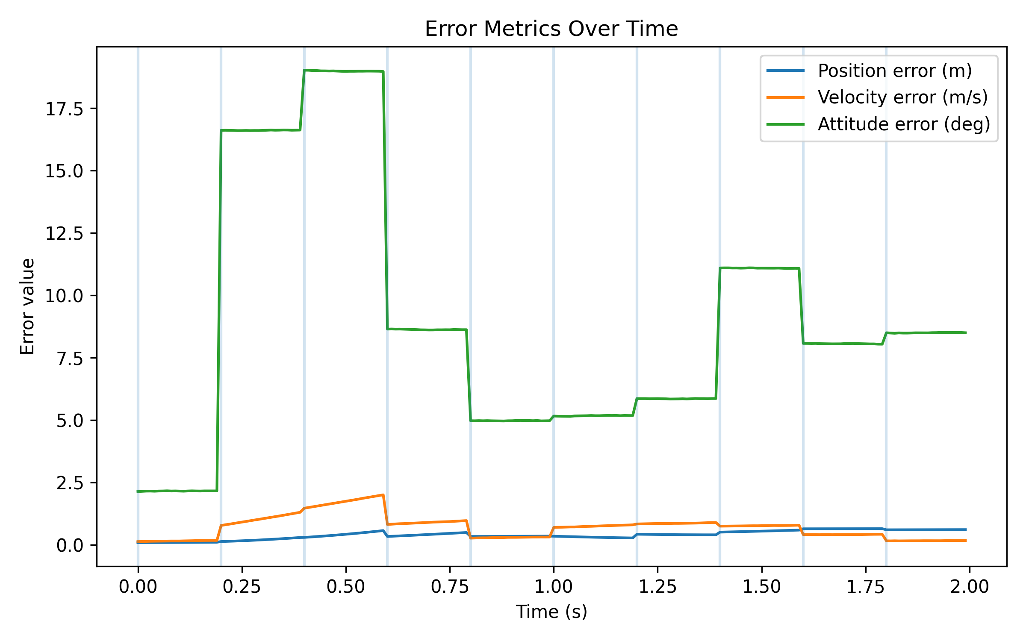
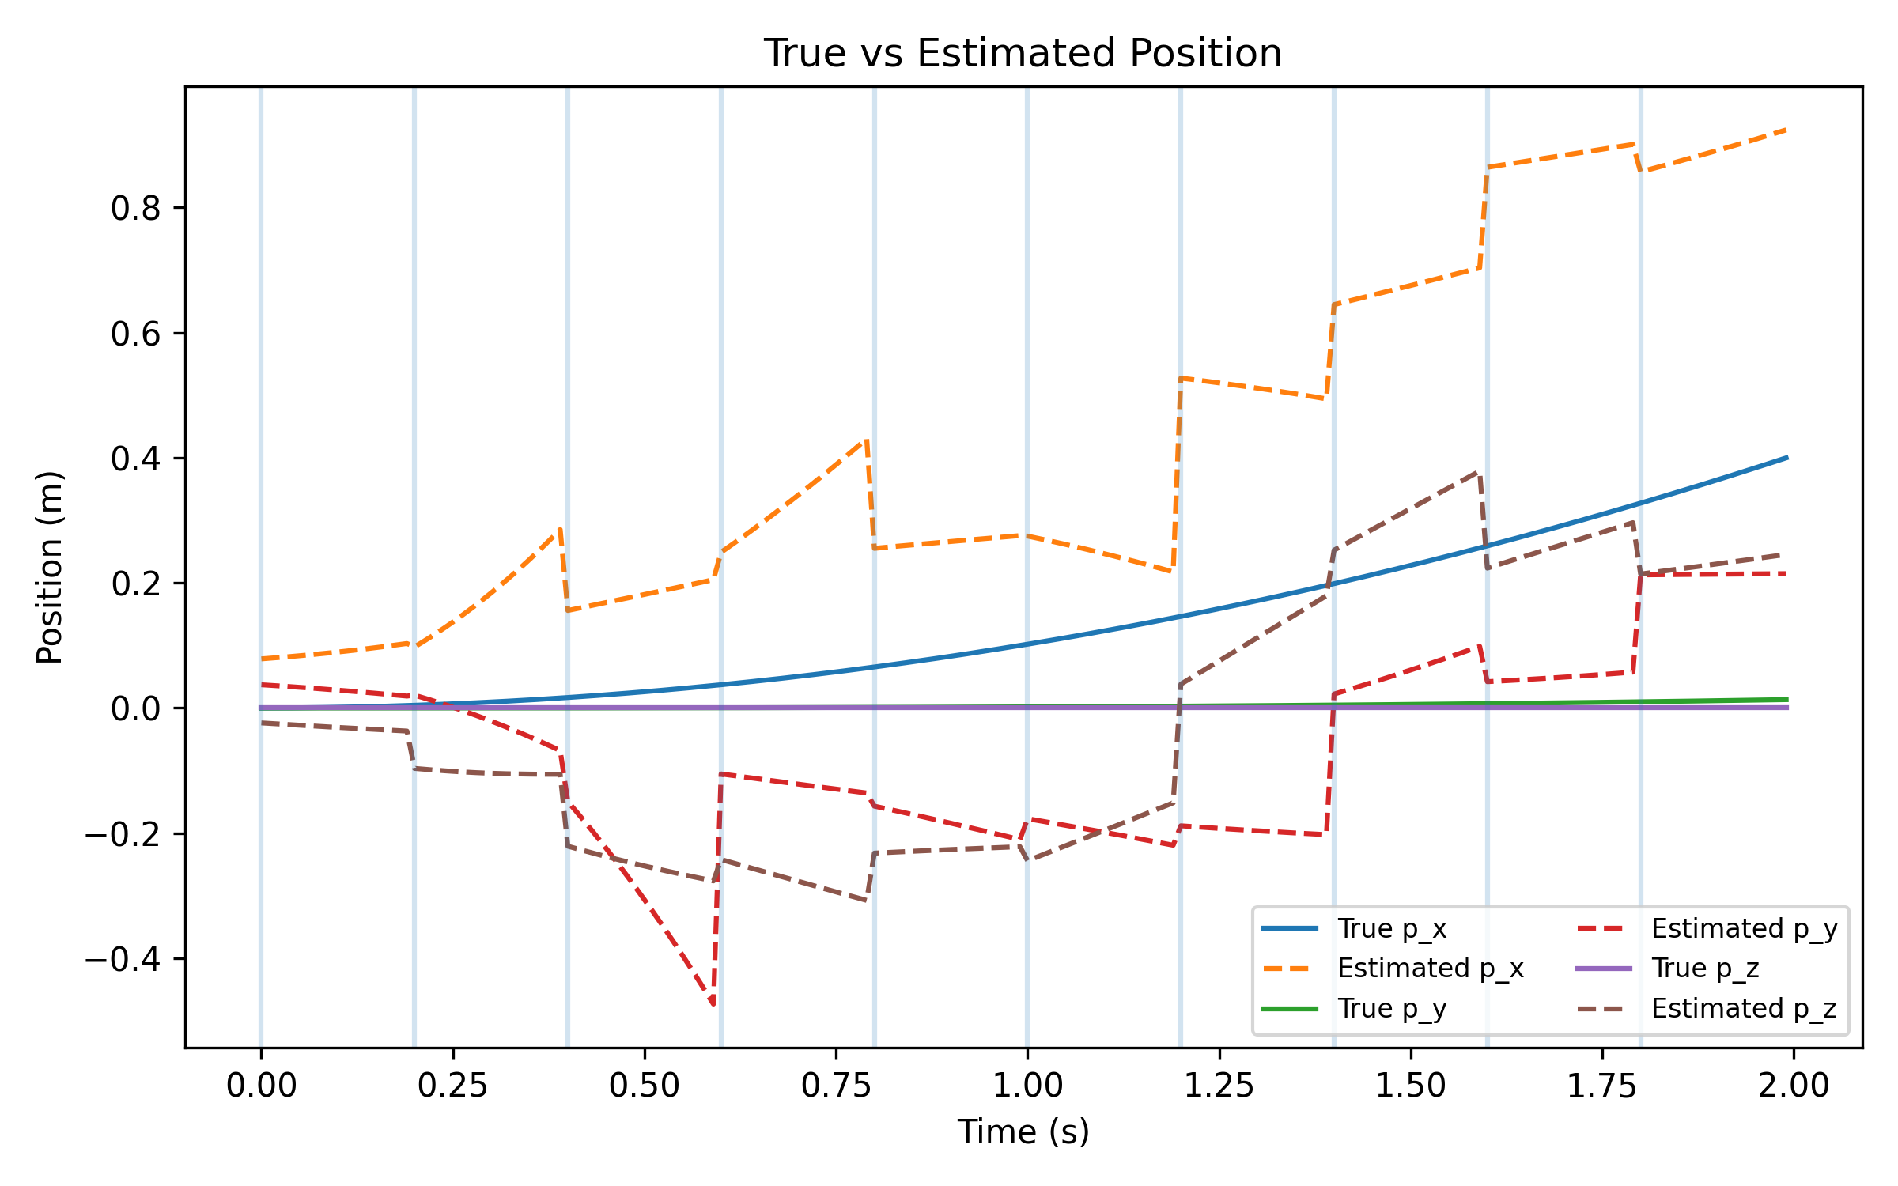
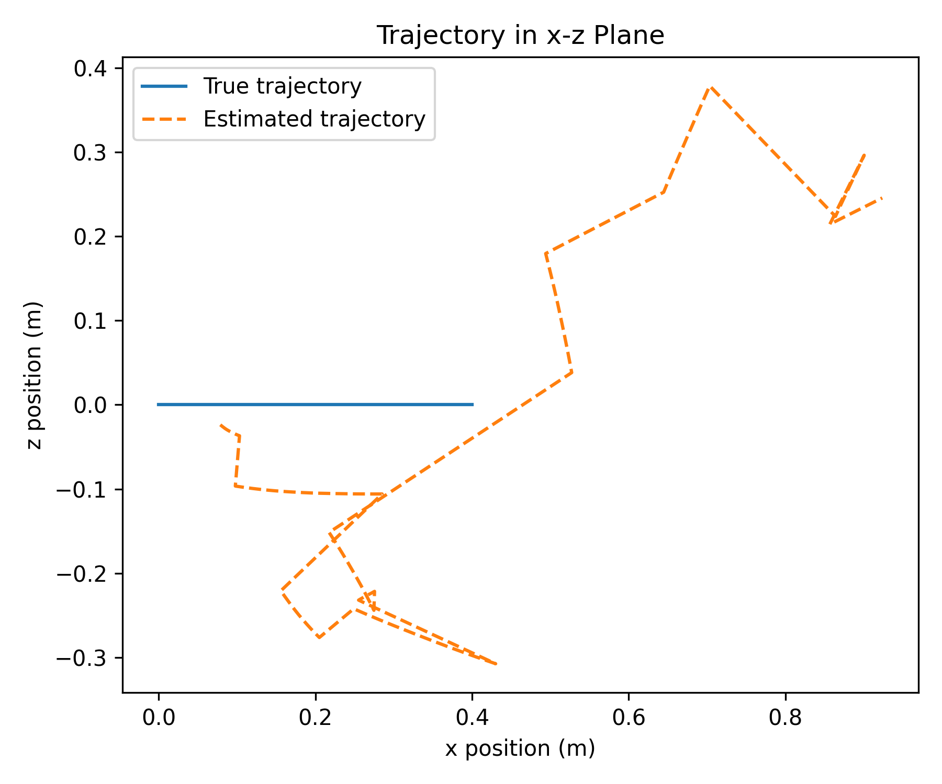
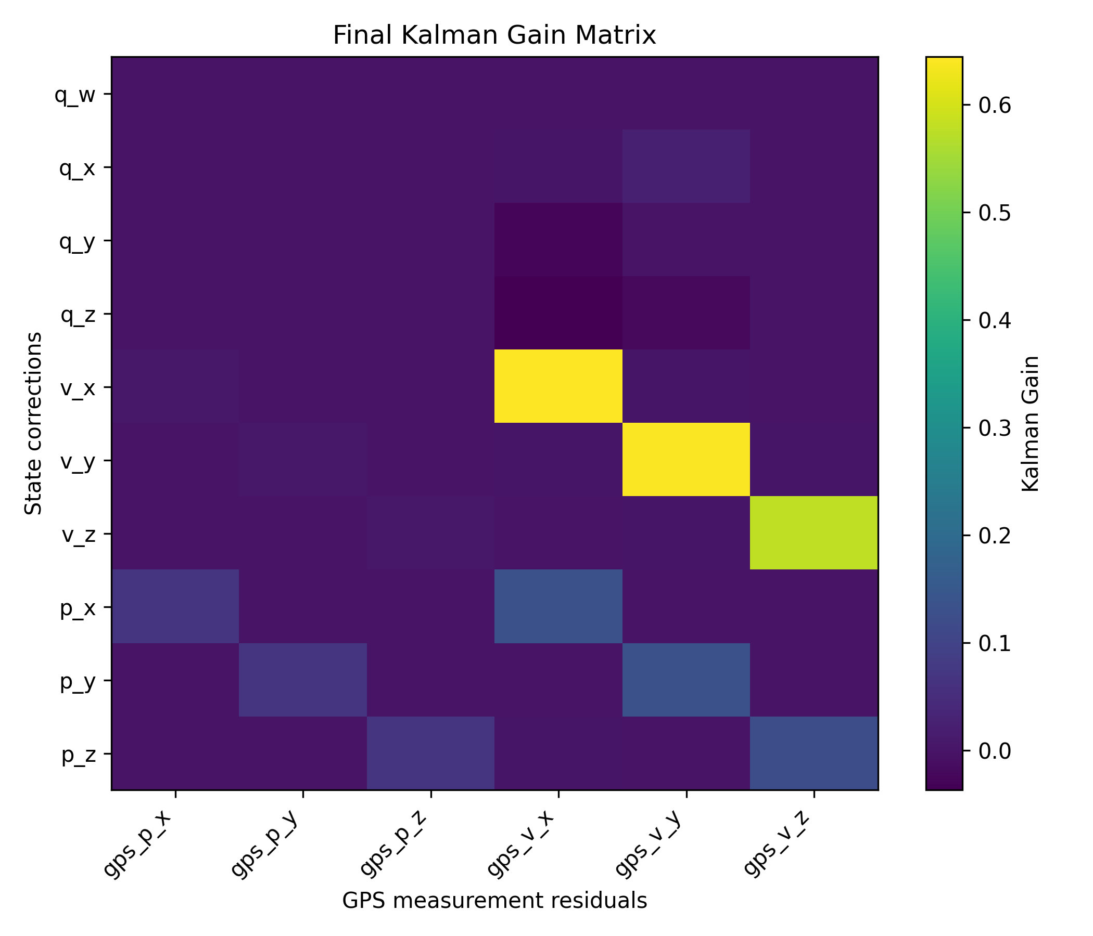
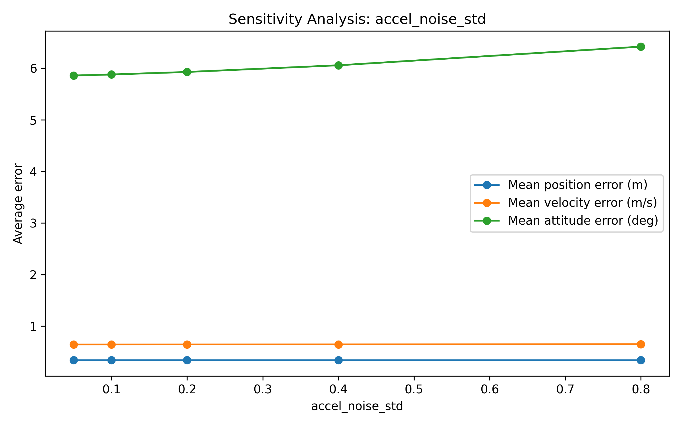
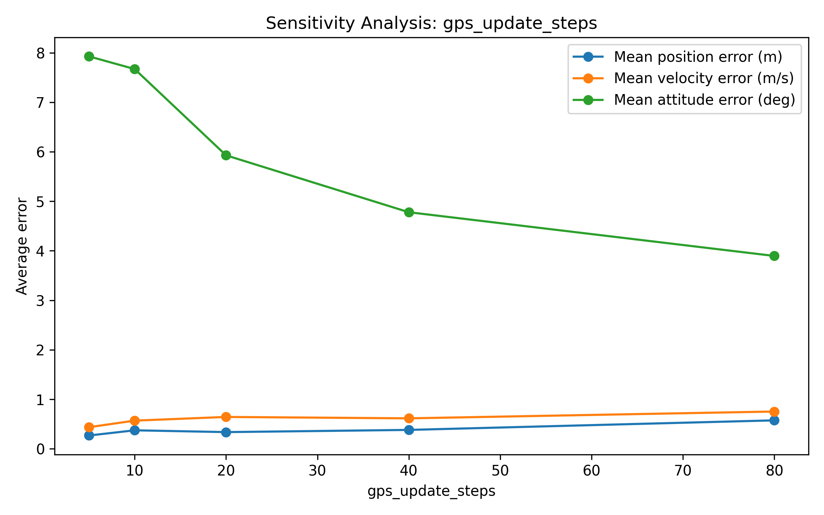
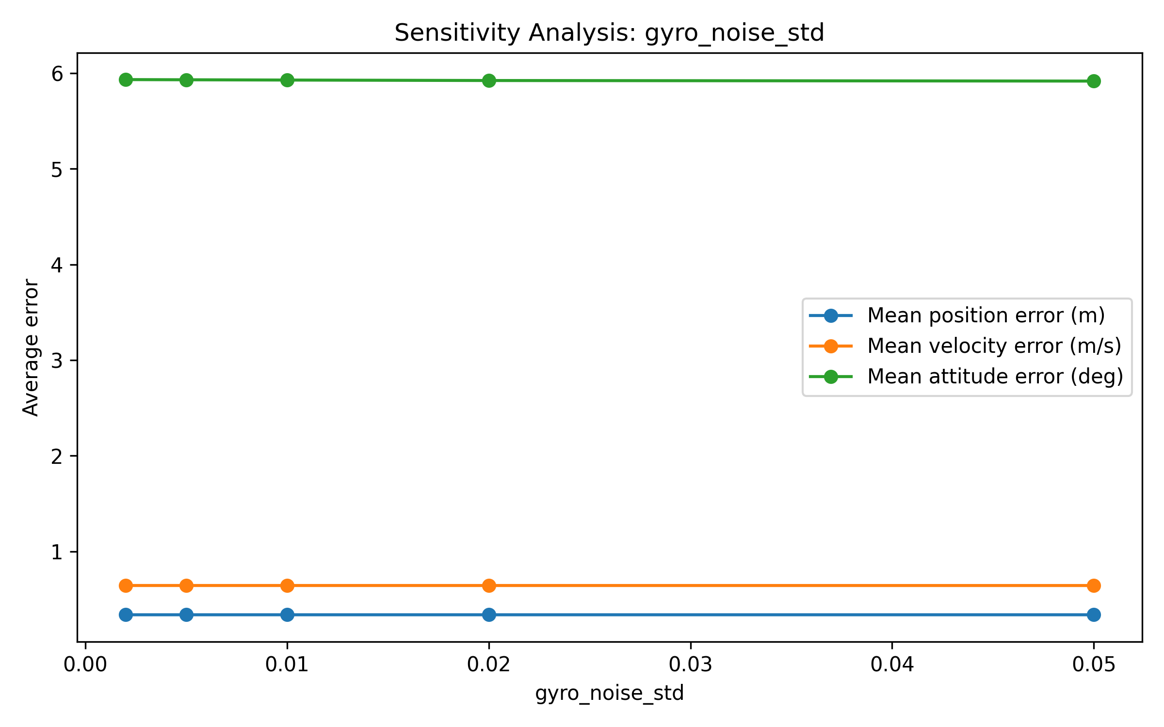
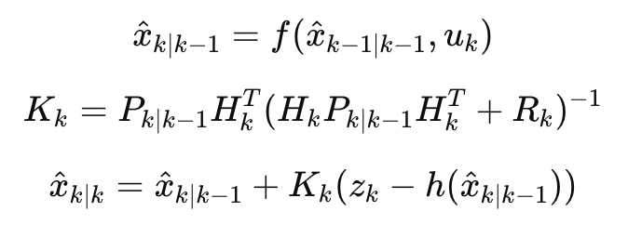
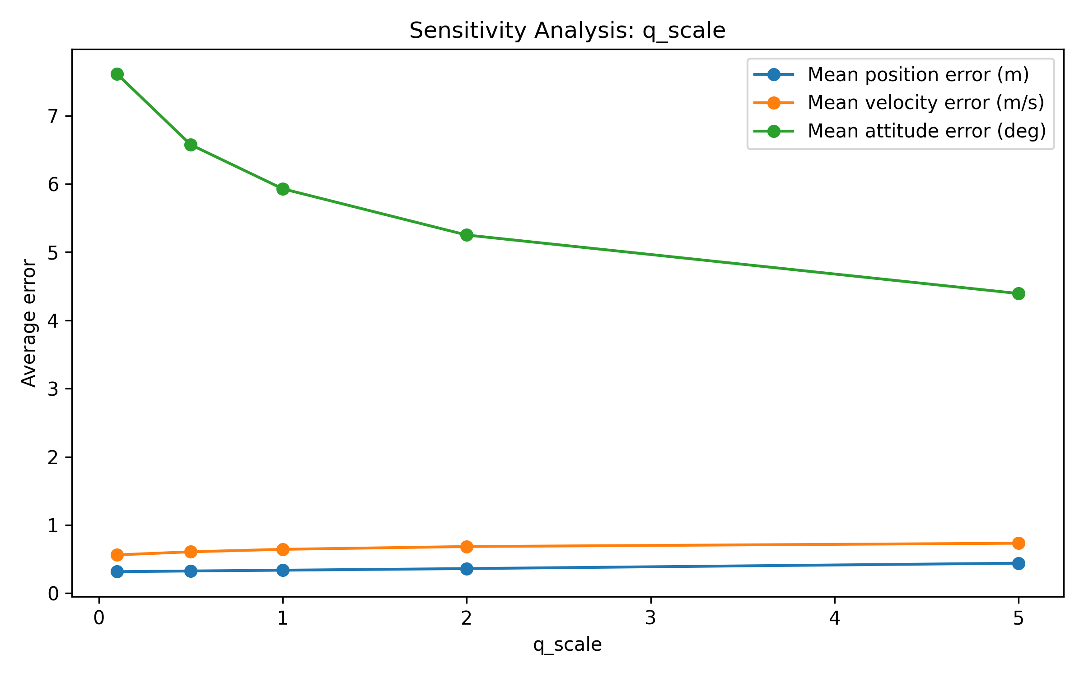
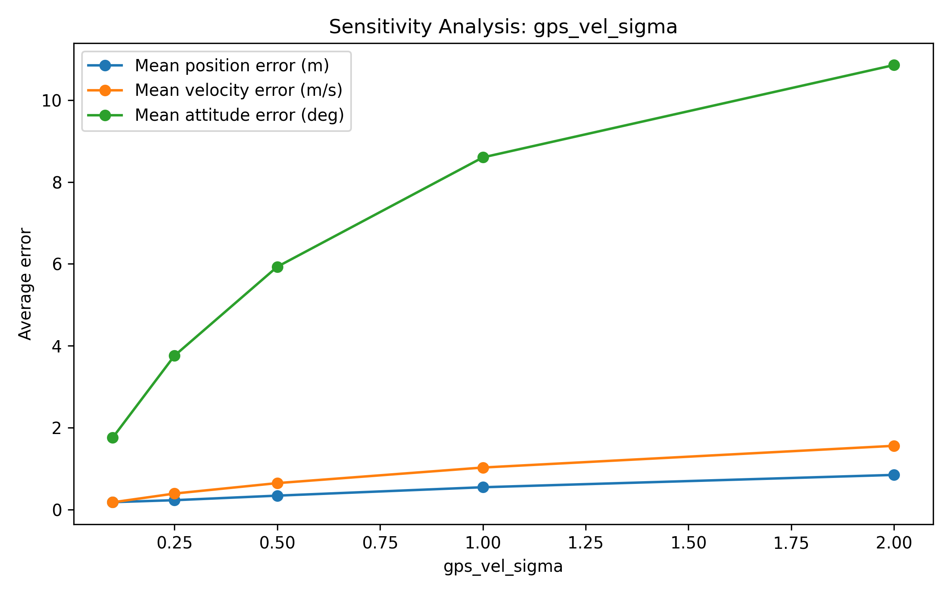
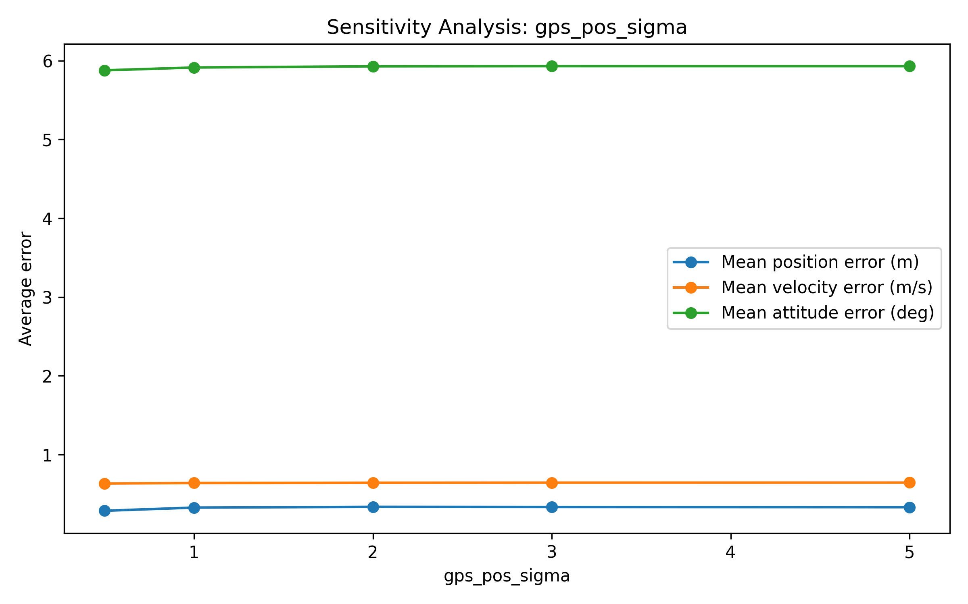
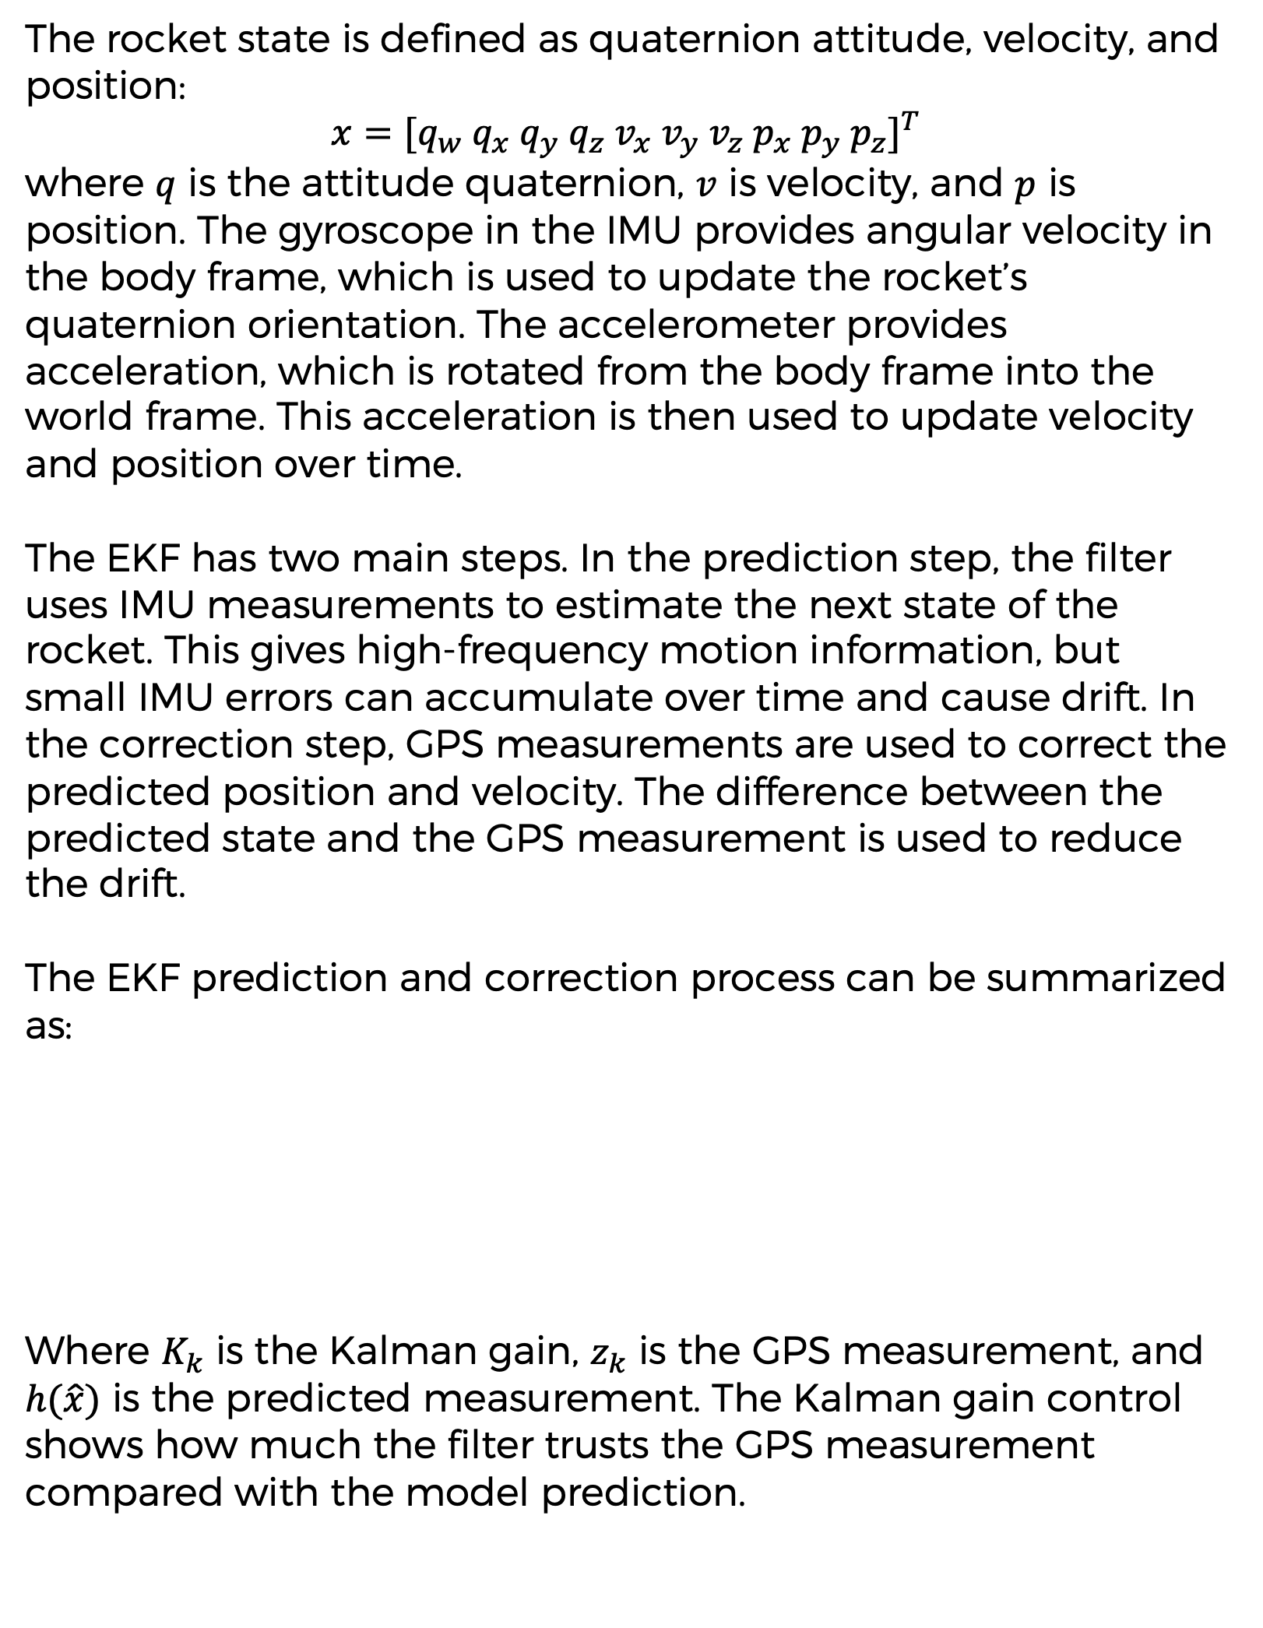
A Study of Rocket State Estimation Using Inertial Measurement Unit and Global Positioning System Data Fusion
Student: Kevin Sun
Mentor: Andrew Voss
Abstract
Results
Discussion
Accurate state estimation is important for rocket navigation because position, velocity, and attitude cannot always be measured directly. This project uses simulated IMU and GPS data with an Extended Kalman Filter to estimate rocket motion. The IMU predicts the rocket state using angular rate and acceleration, while GPS measurements correct accumulated drift. The results show that the EKF estimate follows the general rocket trajectory and keeps errors bounded over time. Sensitivity analysis shows that GPS update frequency and process noise strongly affect estimation accuracy.
GPS measurements help correct this drift by providing external position and velocity information. The EKF uses the prediction step to follow the rocket’s motion and the correction step to pull the estimate back toward the GPS measurement. This allows the filter to maintain a more stable estimate than using IMU data alone.
The main limitation of this project is that the data are simulated. The rocket dynamics and sensor noise are simplified, so the result should be viewed as a framework demonstration instead of a real flight-ready system.
The EKF estimate follows the overall position trend of the simulated rocket in the x, y, and z directions. Although small errors appear during the simulation, the estimated position remains close to the true trajectory.
The position, velocity, and attitude errors remain bounded over time. This shows that the GPS correction helps limit the drift caused by IMU integration. Without correction, small acceleration and angular-rate errors would continue to accumulate.
Conclusion
Materials
This project demonstrates a working framework for rocket state estimation using IMU and GPS data fusion. The Extended Kalman Filter was able to track the general rocket trajectory, correct IMU drift, and keep the estimation error bounded during the simulation. The sensitivity analysis shows that GPS update frequency and process noise are important factors in the filter’s performance. These results suggest that both sensor selection and EKF tuning are important for accurate rocket navigation and guidance.
NumPy
Matplotlib
Simulated IMU data
Simulated GPS data
Extended Kalman Filter algorithm
The x-z trajectory plot shows that the estimated path captures the general shape of the true path. Some deviations appear when the rocket motion changes quickly, which is expected because the filter is working with noisy simulated measurements.
The final Kalman gain matrix shows that GPS measurements strongly affect position-related states. This means the EKF uses GPS data mainly to correct accumulated position error while still using IMU data for high-frequency motion prediction.
Methodology
Future Development
The rocket state is defined as quaternion attitude, velocity, and position:
$x=[q_{w}{ q}_{x}{ q}_{y} q_{z} v_{x} v_{y} v_{z} p_{x} p_{y} p_{z}]^{T}$
where $q$ is the attitude quaternion, $v$ is velocity, and $p$ is position. The gyroscope in the IMU provides angular velocity in the body frame, which is used to update the rocket’s quaternion orientation. The accelerometer provides acceleration, which is rotated from the body frame into the world frame. This acceleration is then used to update velocity and position over time.
The EKF has two main steps. In the prediction step, the filter uses IMU measurements to estimate the next state of the rocket. This gives high-frequency motion information, but small IMU errors can accumulate over time and cause drift. In the correction step, GPS measurements are used to correct the predicted position and velocity. The difference between the predicted state and the GPS measurement is used to reduce the drift.
The EKF prediction and correction process can be summarized as:
Where $K_{k}$ is the Kalman gain, $z_{k}$ is the GPS measurement, and $h(\hat{x})$ is the predicted measurement. The Kalman gain control shows how much the filter trusts the GPS measurement compared with the model prediction.
Future work will test the EKF with real IMU and GPS data from a model rocket or sensor platform. The system can also be improved by adding barometer or magnetometer measurements and using a more realistic 6-DOF rocket dynamics model.
Sensitivity Analysis
The results show that GPS update interval and process noise have the strongest effect on position error. When GPS updates are less frequent, the filter relies more on IMU prediction, so the position error becomes larger. When process noise changes, the filter changes how much it trusts the motion model compared with the GPS measurement.
Gyroscope noise and GPS noise also affect the estimate, but their effects are smaller in this simulation. This suggests that filter tuning is important, not only sensor quality. A well-tuned EKF can reduce drift and improve estimation accuracy.
References
1. Josselson, R. Introduction to 6-DOF Simulation of Air Vehicles. 1997.
2. Lee, J. K., Edward J. Park, and Stephen N. Robinovitch. “Estimation of Attitude and External Acceleration Using Inertial Sensor Measurement During Various Dynamic Conditions.” IEEE Transactions on Instrumentation and Measurement, vol. 61, no. 8, 2012, pp. 2262–2273.
3. Zheng, Albert, et al. “Integrated State Estimation Development for Actively Controlled Rockets.” 2025 Regional Student Conferences, American Institute of Aeronautics and Astronautics, 2025.
Acknowledgements
I would like to thank my mentor, Andrew Voss, for guidance and feedback throughout this project.

